Slide 1
I– Irrigation E – Electrical D – Districts A - Association
Ed Gerak
Irrigation & Electrical Districts Association of AZ, Inc.
September 19th, 2023

Slide 2
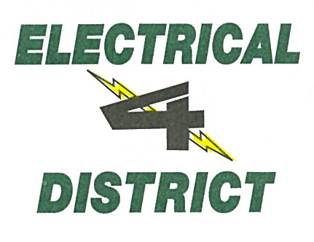
Irrigation & Electrical Districts Association of Arizona, Inc.
Notes:
A Collection of 25 Irrigation, Electrical Districts, Co-Op, Municipalities and two Tribal Utilities

Slide 3
Priorities
Federal Hydropower (APA, CREDA, P-DP, WAPA)
Federal Legislation
State Legislation
National/State Associations (APPA, ABWC/NWRA, NRECA)
Association Operations (Meetings, Finance, Communication, Outreach)

Slide 4
Proposed By-Laws
Current By-Laws Have Redundancy (Meetings)
Discrepancies (E.C. Membership, Contradictory Statements)
Omissions (Executive Director)
Alignment (Rewritten to Reflect Current Operations)
Meetings Format
New Members Requests
Finance/Annual Report

Slide 5
Executive Committee
Currently has 4 Members
By-Laws Allow for Up to 6
Expand Executive Committee
Request to Revise Election Timeframe
Nomination Committee
E.C. Report at Board Meeting

Slide 6
Possible Committees
Federal Legislation
State Legislation
Water Committee
Power Committee
Finance Committee
Nominating Committee

Slide 7
Meetings
Location
Date/Time
Format
Reports

Slide 8
Annual Meeting
Welcome—Jim Pratt, SRP CEO
Arizona Water—Tom & Brenda
Water Infrastructure Finance Authority
DC & SCOTUS Update - APPA
Capitol Times – Congresswoman Lesko & Speaker Toma
What are the Polls Saying - Mike Noble, OH Predictive Insights
Western Area Power Administration – DSW & CRSP
Arizona Farm Bureau
State Power Issues

Slide 9
Activities
Travel
IEDA Fly-In
Leadership Program
Internship Program (In Development)

