Slide 1
Lower Basin States Proposal, Supplemental Environmental Impact Statement (SEIS)
Vineetha Kartha, Colorado River Programs Manager
Darrin Francom, Assistant General Manager, OPEM
June 13, 2023

Slide 2
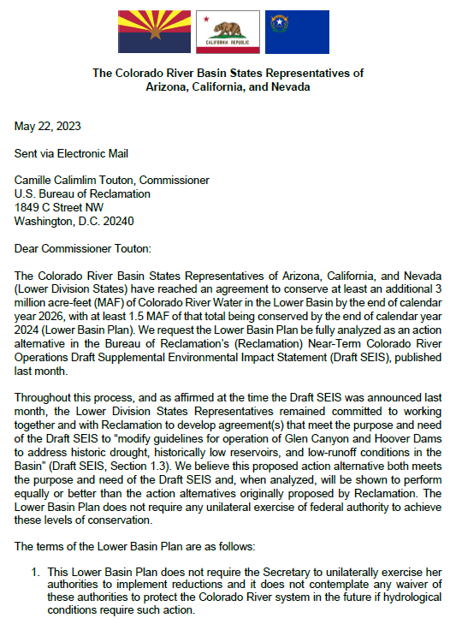
SEIS Timeline and Status
April 14, 2023
SEIS Published,45-day Comment Period (May 30, 2023 – Comments Due)
May 22, 2023
Lower Basin Submitted Consensus Proposal
DOI – Temporary Withdrawal of the Draft SEIS, Analyze Effects of Lower Basin States Proposal Under NEPA (May 26 Federal Register Notice)
Original May 30th Comment Deadline Rescinded
Reclamation Will Publish Updated Draft SEIS With New Alternative Analyzed
SEIS Process To Be Finalized Later This Year
Notes:
Reclamation is working through the details of how it will proceed further. It is likely that the ROD will not be published until December 2023. However that will still give Reclamation the ability to make changes to GCD operations in 2024 through a mid-year review if needed.

Slide 3
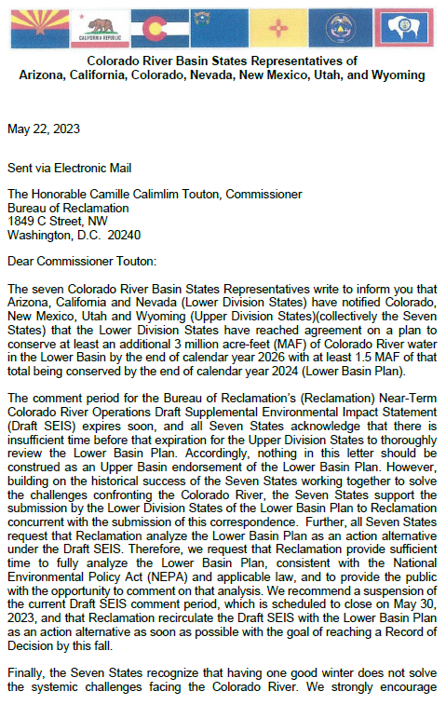
Seven Basin States Letter
May 22nd: Support Proposal by the Lower Division States
Even with One Good Winter – Systemic Colorado River Challenges Remain
Encourages Reclamation Advance Development (Post 2026 Guidelines)
Requests Reclamation Publish Notice of Intent for EIS for Post-2026 Guidelines no later than June 30, 2023.
Colorado River Discussions

Slide 4
Lower Basin States Proposal Overview
Consider Changed Conditions
Implement 3 MAF of conservation through 2026, 1.5 MAF by 2024, not attributed by State
Up to 2.5 MAF of Conservation Federally Compensated
2.3 MAF “Inflation Reduction Act”
0.2 MAF Bipartisan Infrastructure Law Funds and other funds
Additional Elevation Triggers to Protect Mead & Powell
Reclamation actions
Notes:
Of the 2.5 MAF Federally compensated 2.3 MAF bucket 1 0.2 MAF Bucket 2

Slide 5
Lower Basin States Proposal
 | 2023 | 2024 | 2025 | 2026 | 4-year total
Additional Conservation State
California (KAF) | 400 | 430 | 430 | 350 | 1.6 MAF
Arizona (KAF) | 375 | 375 | 375 | 20 | 1.15 MAF
Nevada (KAF) | 75 | 75 | 75 | 65 | 285 KAF
Total Additional Conservation | 840 | 880 | 870 | 430 | 3.0 MAF
KAF - thousand acre-feet, MAF - million acre-feet
None of the 3 MAF Created by Mandatory Reduction (voluntary)
All Conservation Volumes Are “In Addition To”
2007 Interim Guidelines, the Lower Basin DCP, and Minute 323
Notes:
These volumes include agreements that are in place (Like Gila River Ft. McDowell and CAP subcontractors) and agreements that are still in progress. The Proposal did not specifically include attribution by State
2.3 MAF of the conservation will be funded under the Inflation Reduction Act
The Bipartisan Infrastructure Law funding or other federal monies may offset 0.2 MAF of the remaining required System Conservation
The remaining required System Conservation may be in whole or part compensated by the state, local entities or be uncompensated

Slide 6
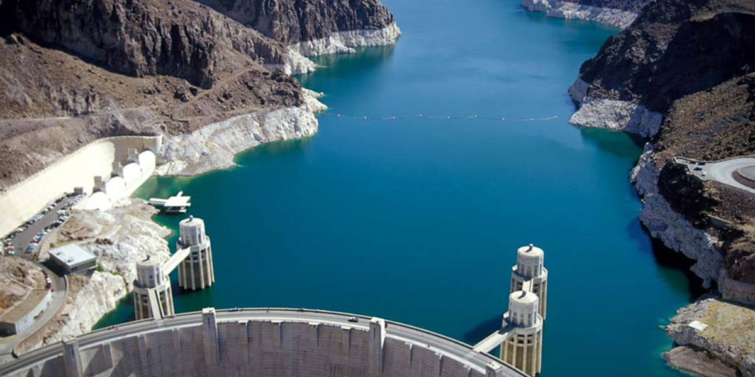
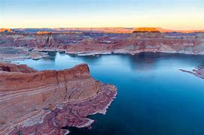
Lower Basin States Proposal
Conservation Volumes:
System Conservation or Intentionally Created Surplus
Due to limitations in ICS Storage Space:
Some DCP ICS Will Become System Water
ICS Created Toward System Conservation Volumes:
Cannot be delivered, transferred or assigned before December 31, 2026

Slide 7
Lower Basin States Proposal - Triggers
If Mead Below 1,025 feet (in April 24 MS Minimum Probable in 2024, 2025, and 2026):
Lower Division States: 45 days to Propose Plan to Reclamation, Protect From Going Below 1,000 feet
If Plan Not Developed:
Reclamation Take Independent Actions to Protect 1,000 feet
If Lake Powell Below 3,500 feet (in any of the upcoming 12 months, any 24 MS Minimum Probable projections):
Reclamation (mid-year adjustment):
Reduce Powell Release to no less than 6.0 MAF
After Other Actions Have Been Taken
Colorado River Discussions
Notes:
Failsafe in the event that 3MAF is insufficient

Slide 8
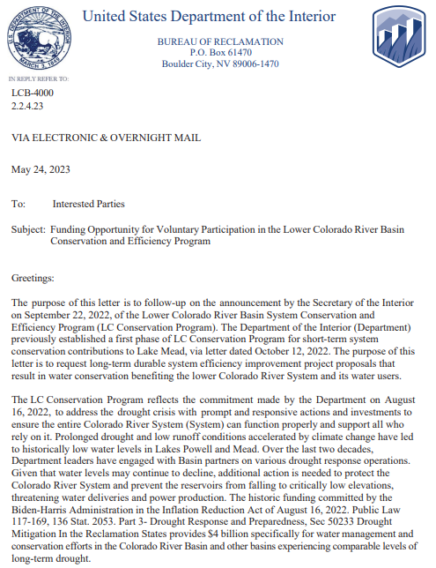
Reclamation “Bucket 2” Funding Announcement
May 24: Reclamation Issued Funding Opportunity for Voluntary Participation in the LC Conservation and Efficiency Program.
“Bucket 2” Funding Pool (Inflation Reduction Act)
Eligible Projects Include (but not limited to):
Canal Lining and Conveyance System Rehabilitation
Agricultural Upgrades (Technology or Management)
Urban Water Efficiency Projects
Non-Functional Turf Replacement
Water Storage Projects Lead to Operational Flexibilities
Proposals must be submitted electronically to Reclamation by July 19, 2023.
Colorado River Discussions

Slide 9
Questions?

